Slide 1




Slide 2
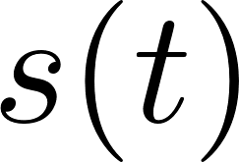

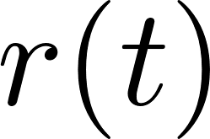
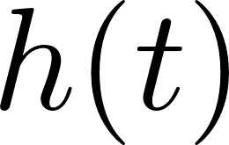

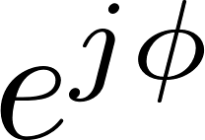

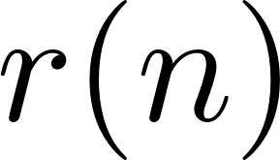
iNET
Packetizer
SOQPSK-TG
Modulator
Channel
Data Bits
Down-Convert &
Filter
Resample
RF
IF
ADC
Received Signal

Slide 3
128
bits
64
bits
6144
bits
Preamble
ASM
Data
6336 bits
Data
Preamble
ASM
Data
Preamble
ASM
Data

Slide 4



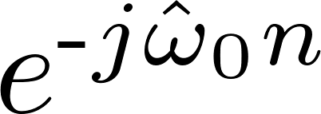
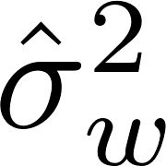




Preamble
Detector
Frequency
Offset
Estimator
Estimators
Equalizer
(Filter)
Detection
Filter
OQPSK
Detector
2

Slide 5
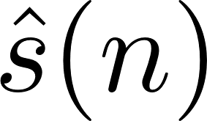
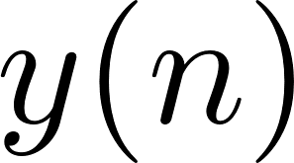
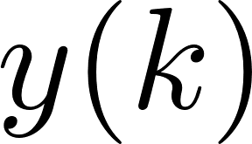
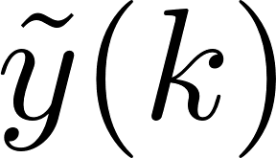

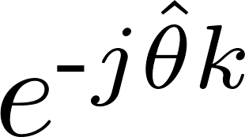
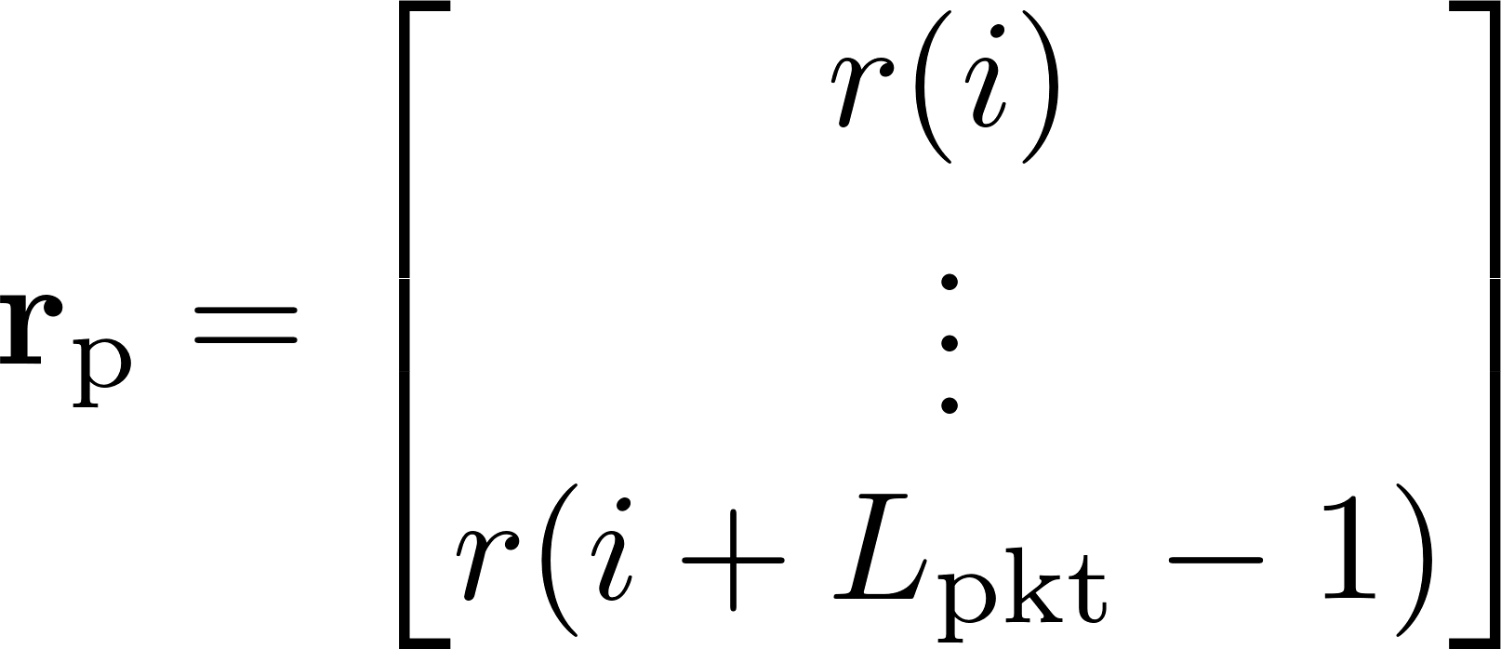
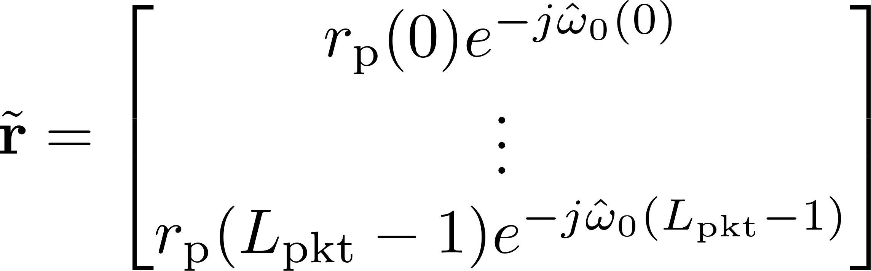
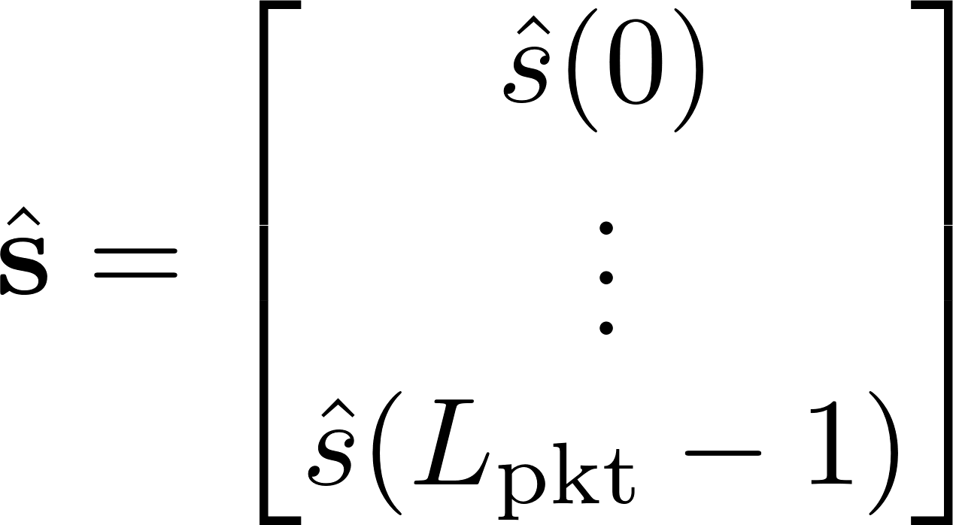
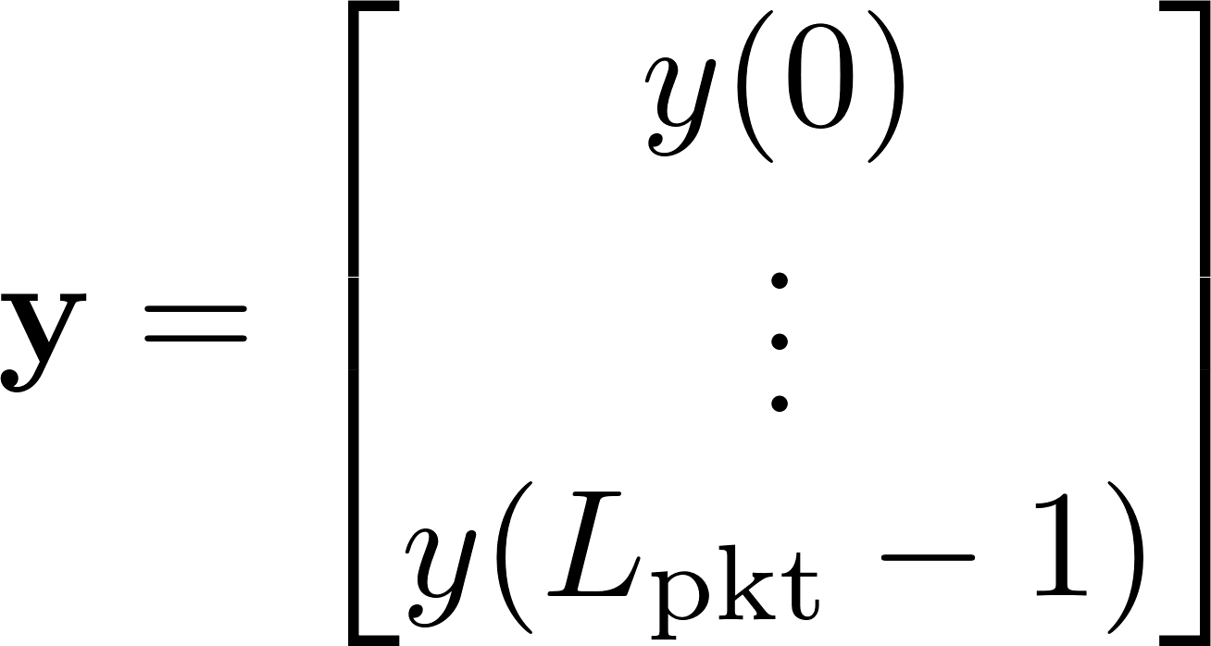
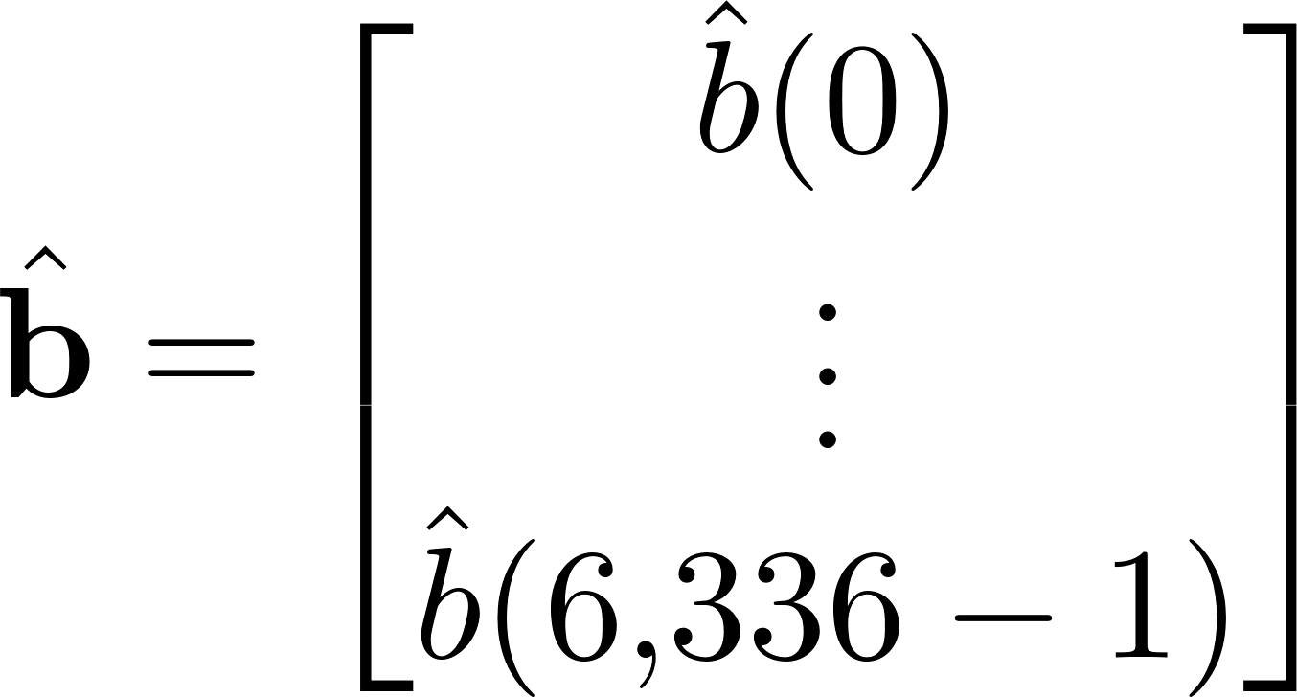
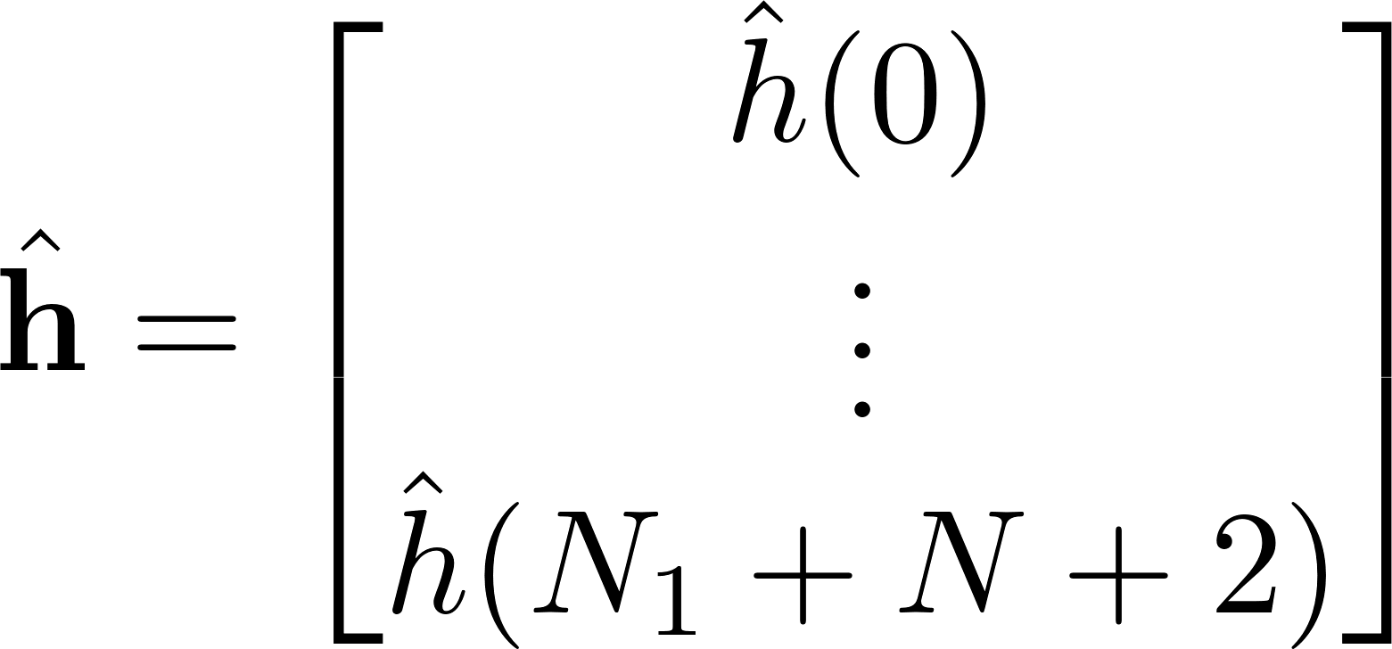
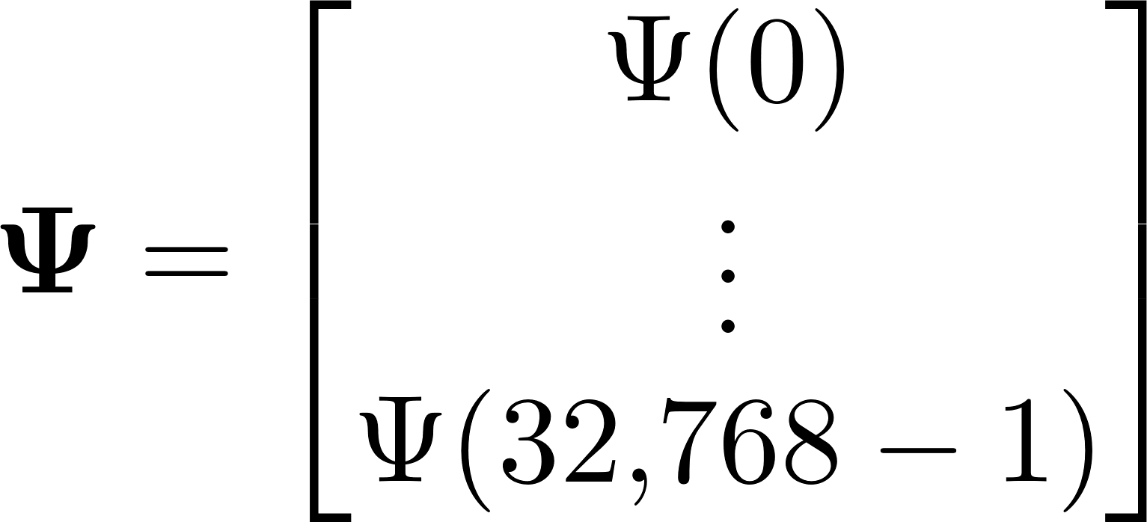
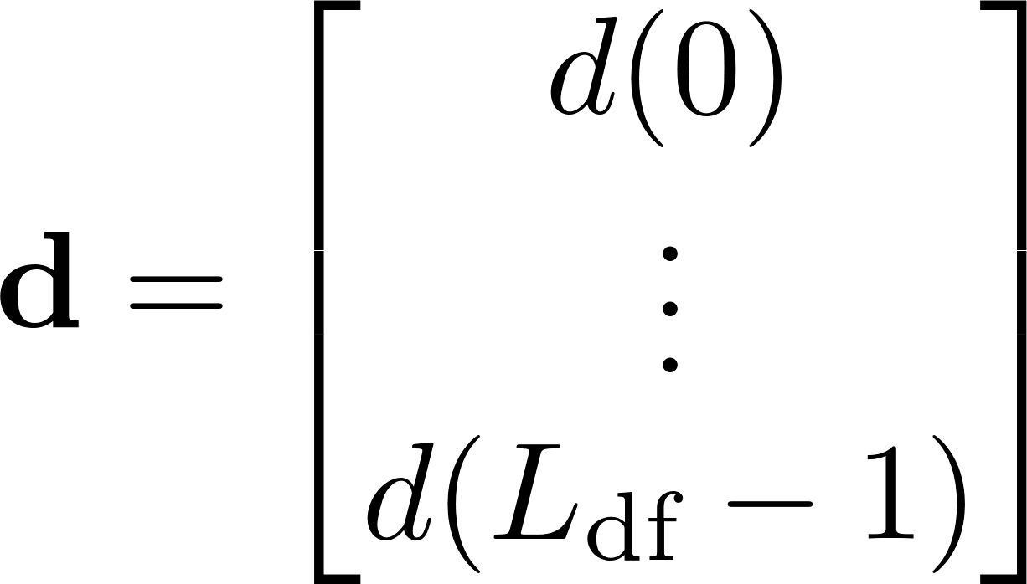
Preamble
Detector
Equalize
Detection
Filter
2
Frequency
Offset
Estimator
PLL
Estimators

Slide 6










Compute ZF
Filter
Apply Filters
OQPSK
Detector
Compute MMSE
Filter
Apply Filters
OQPSK
Detector
Compute CMA
Filter
Apply Filters
OQPSK
Detector
Compute FDE1
Apply Filters
OQPSK
Detector
Compute FDE2
Apply Filters
OQPSK
Detector

Slide 7




Slide 8
T/M Receiver & Demod
RF
70 MHz IF
Samples
Bits
T/M Receiver
ADC
Host CPU
Host CPU
FPGA
FPGA
BERT
K40c GPU
K20c GPU
K20c GPU
Rack Mounted Server
Rack Mount Case

Slide 9
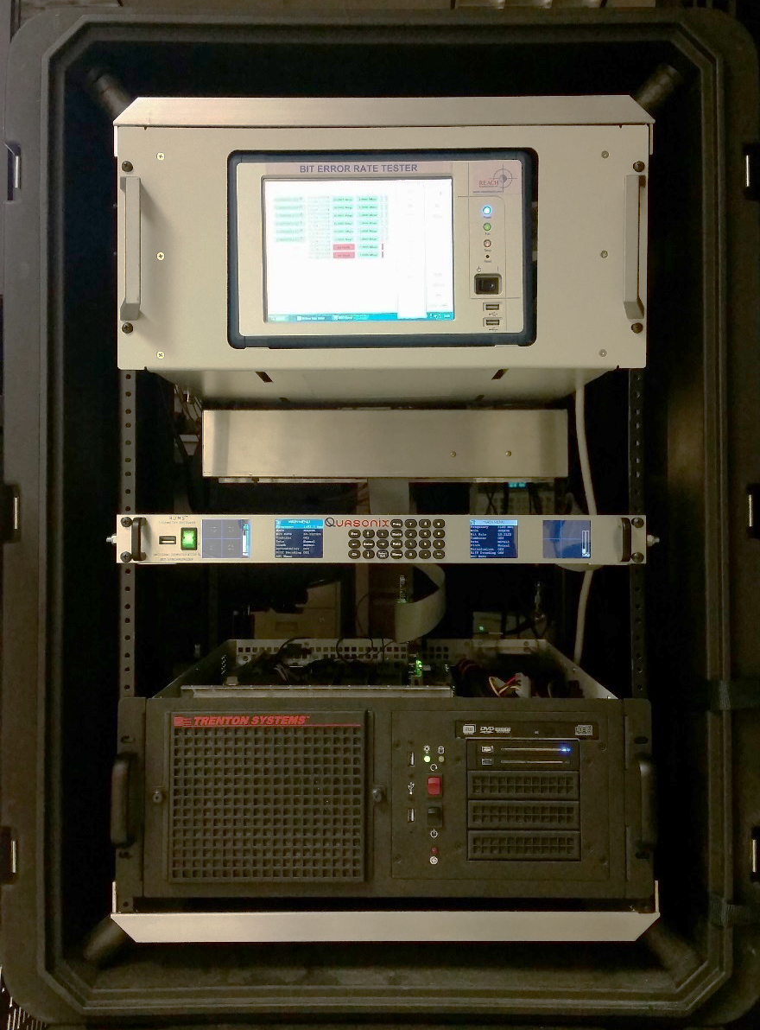
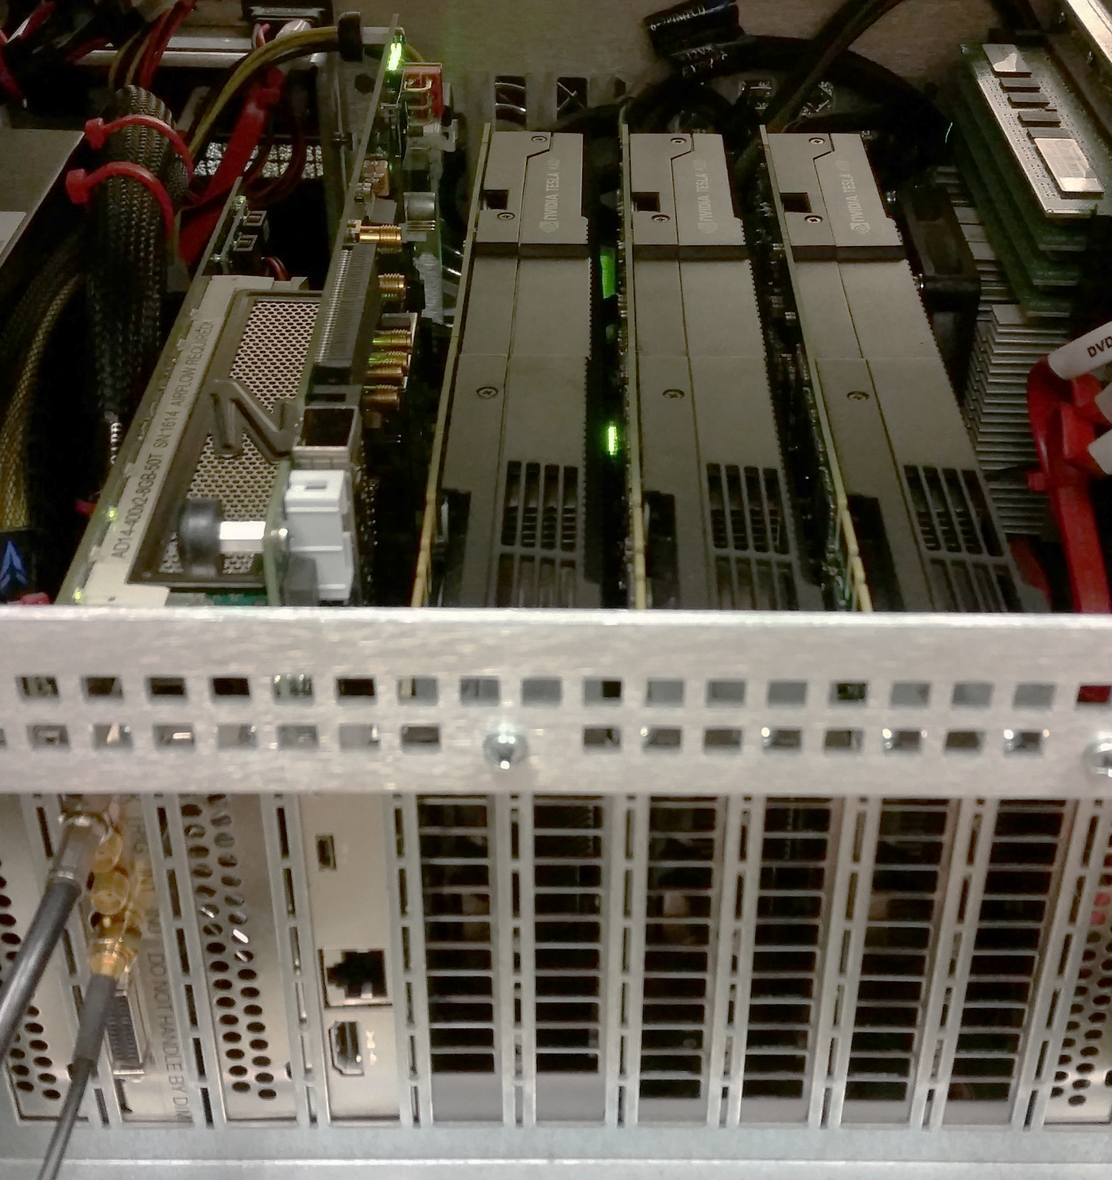
Host
CPU
BERT
T/M Receiver
Rack Mounted
Server
Rack Mount
Case
ADC
FPGA
K40c
GPU
K20c
GPU
K20c
GPU

Slide 10
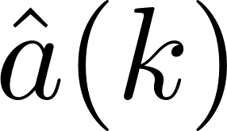
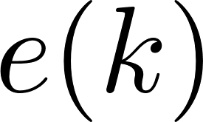

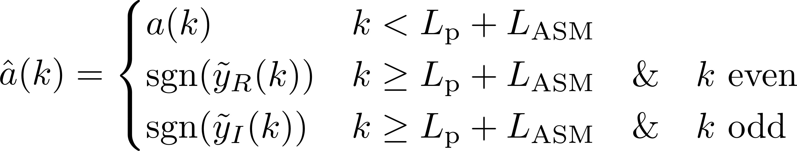
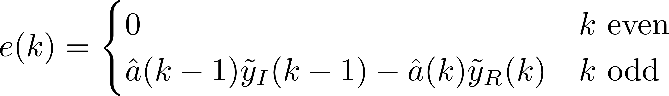
Detection
Filter
2
DDS
PED

Slide 11
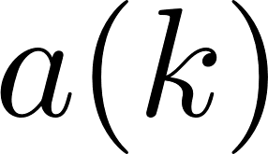

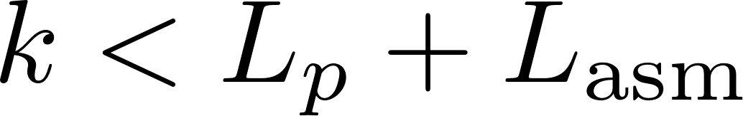
Detection
Filter
2
MUX
DDS
PED

